Slide 1

Dishcovery
High-Fi Prototype V2
Abena Ofosu, Sharon Wambu, Kayla Kelly, Defne Genc

Slide 2
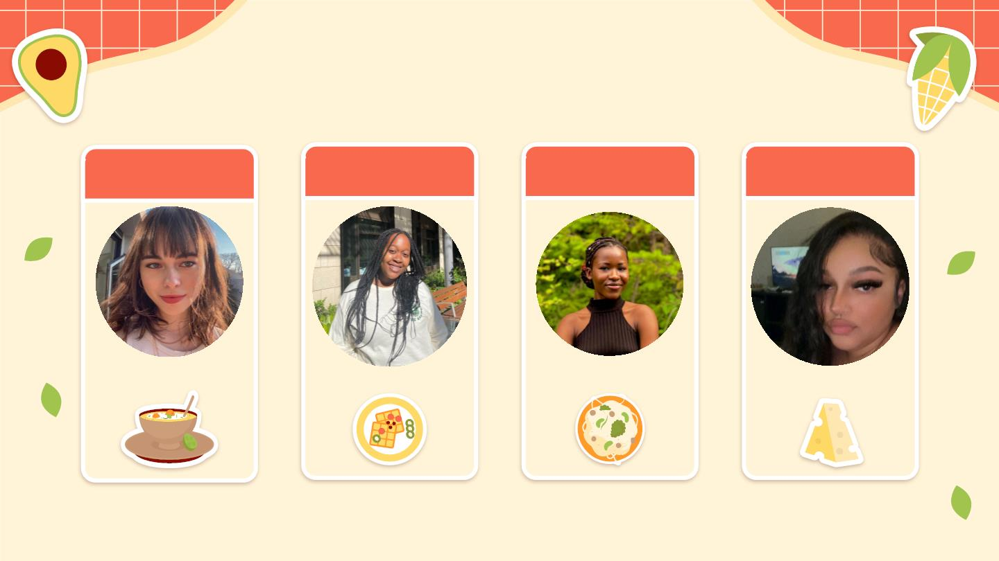
Our Dishcoverers
Defne
Sharon
Abena
Kayla
Dish of choice:
Dish of choice:
Dish of choice:
Dish of choice:

Slide 3
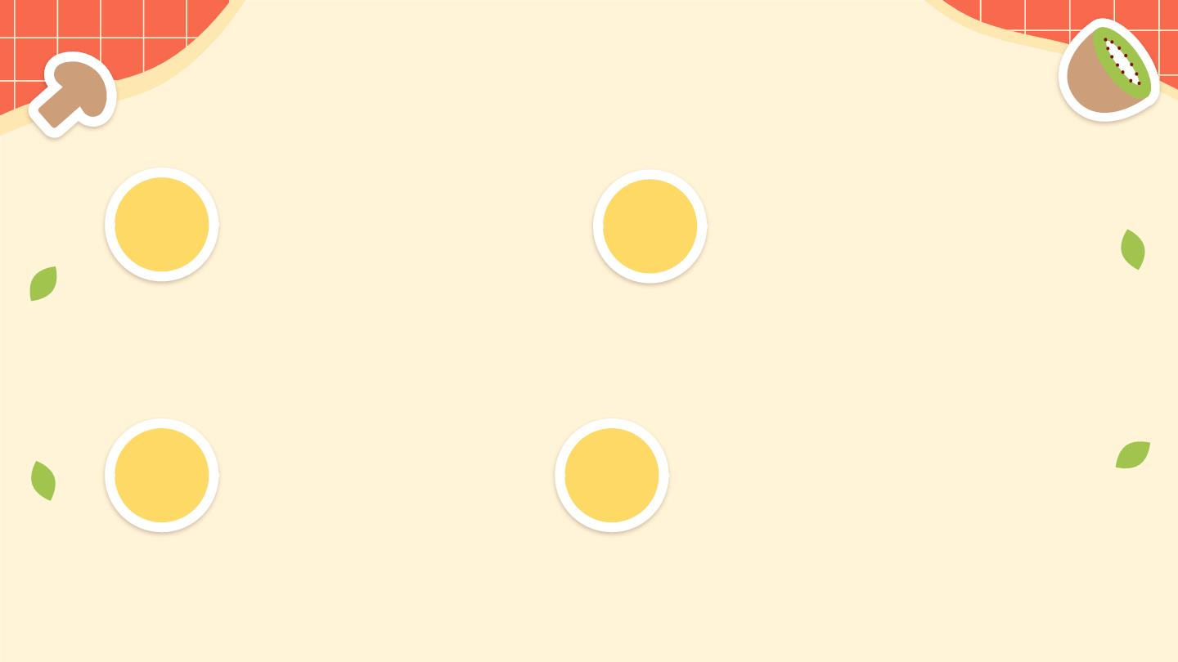
Presentation Outline
A Recap
Task Flows
01
03
A quick walk through the
execution of each task.
Improvements to our
interface.
Interface
Future Trajectory
What we want to improve
and implement.
02 ^{Changes}
04
Changes we’ve made
based on takeaways from
testing.

Slide 4
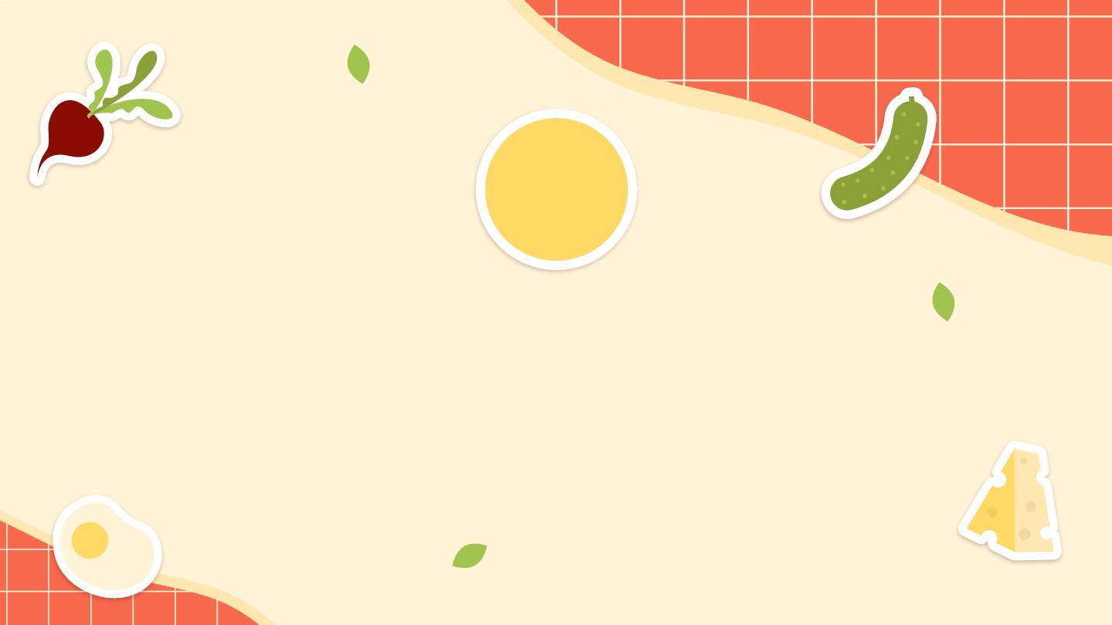
01
Introduction

Slide 5

Problem Statement
Learning about and creating
food with ingredients from
other cultures can be an
intimidating experience.

Slide 6

Our Solution
Dishcovery helps you
recognize, learn about, and
cook with foods from
around the world.

Slide 7
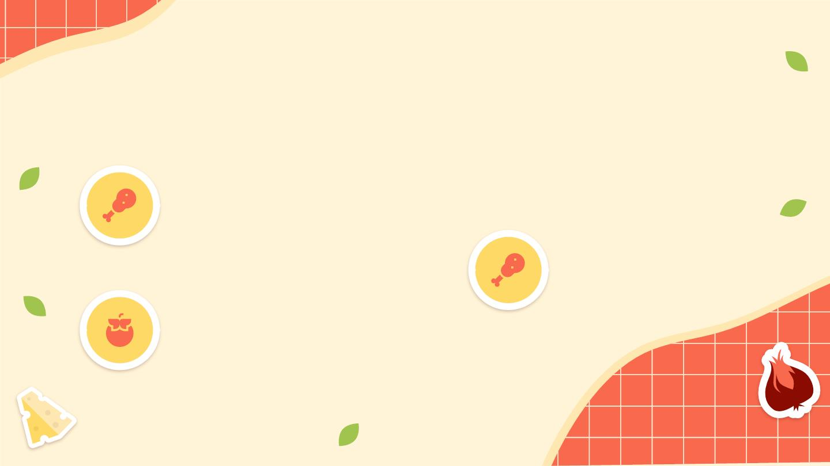
Proposed Value Propositions
Culinary Exploration
Dishcovery makes unfamiliar
ingredients speak for
themselves
Integrity
Unique method of sourcing
guarantees authenticity
Cultural Transmission
Bridge the knowledge gap
preventing users from trying
new recipes

Slide 8
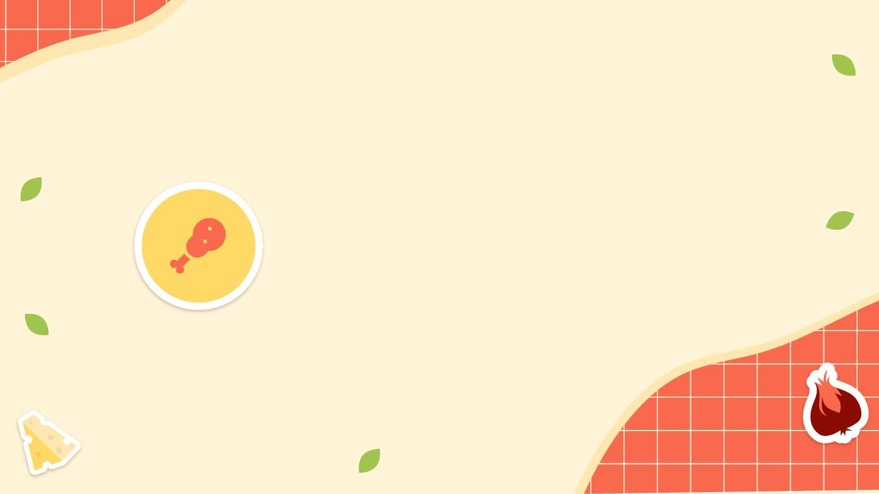
Unique Value Proposition
Culinary Exploration
Dishcovery makes unfamiliar ingredients speak
for themselves

Slide 9
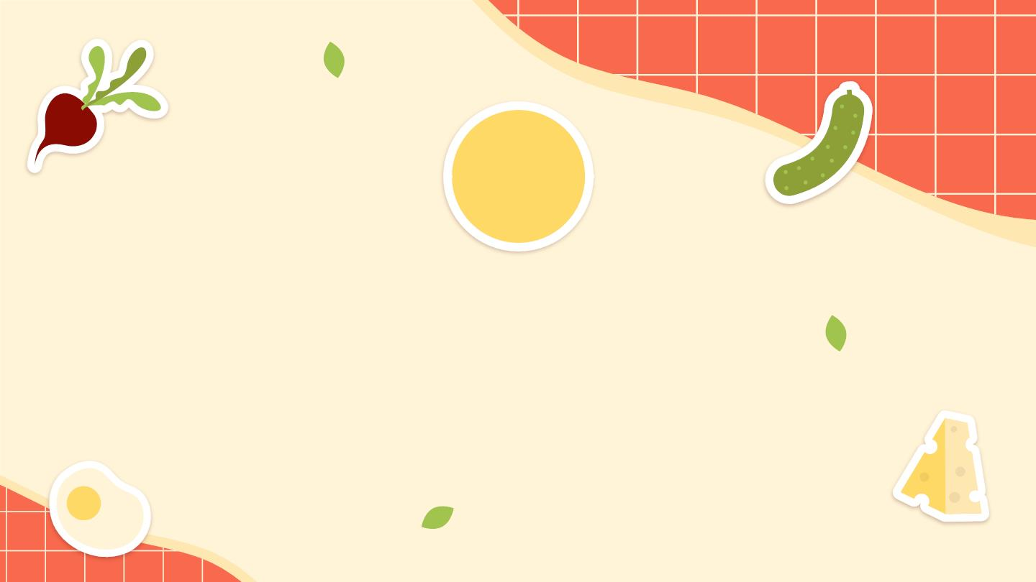
02
Interface
Changes

Slide 10
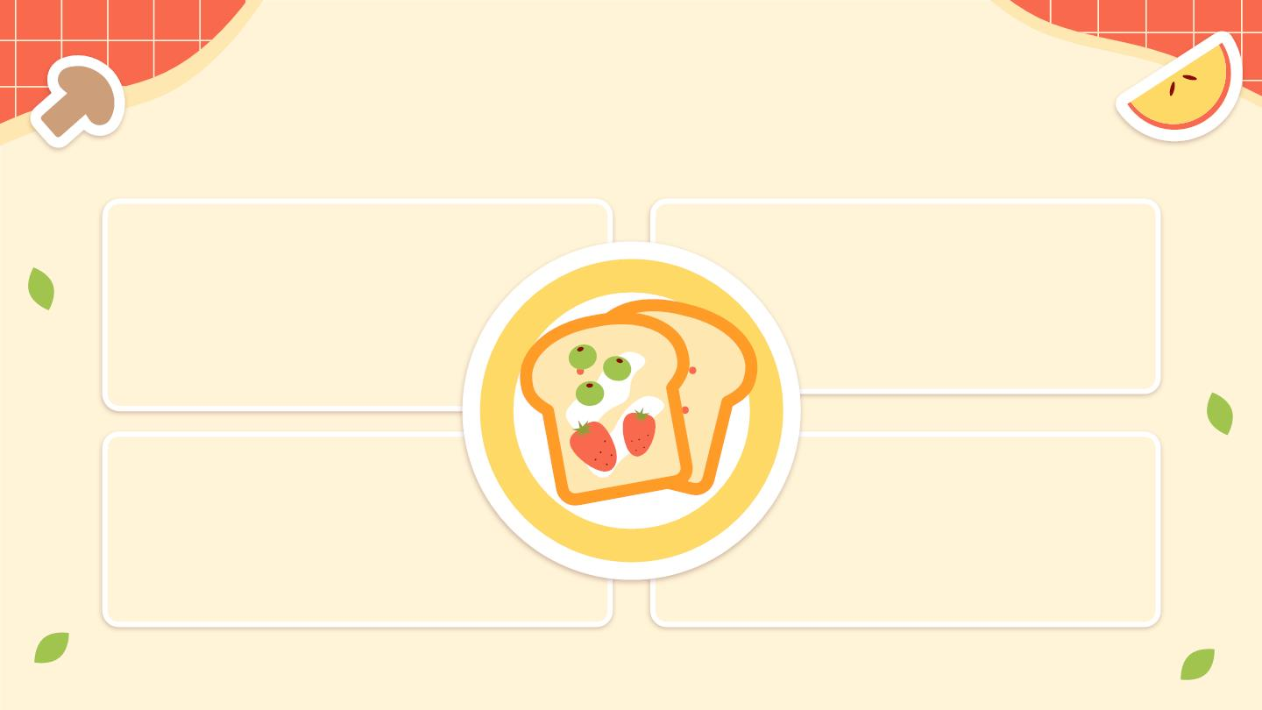
Usability Testing Takeaways
Eﬃciency
Learnability
Relevant context and recipes.
Scanning and browsing.
Make sure to include suﬃcient
onboarding to make central
functionality (scanning) clear.
Take into account the information
participants said they felt were
most valuable on the app.
Discarding unnecessary
steps.
Things like double scan
conﬁrmation could become more
intuitive.
Ordering of tasks.
Giving the user the option to see
recipes before reading the context,
in case they have already or would
not prefer to.

Slide 11
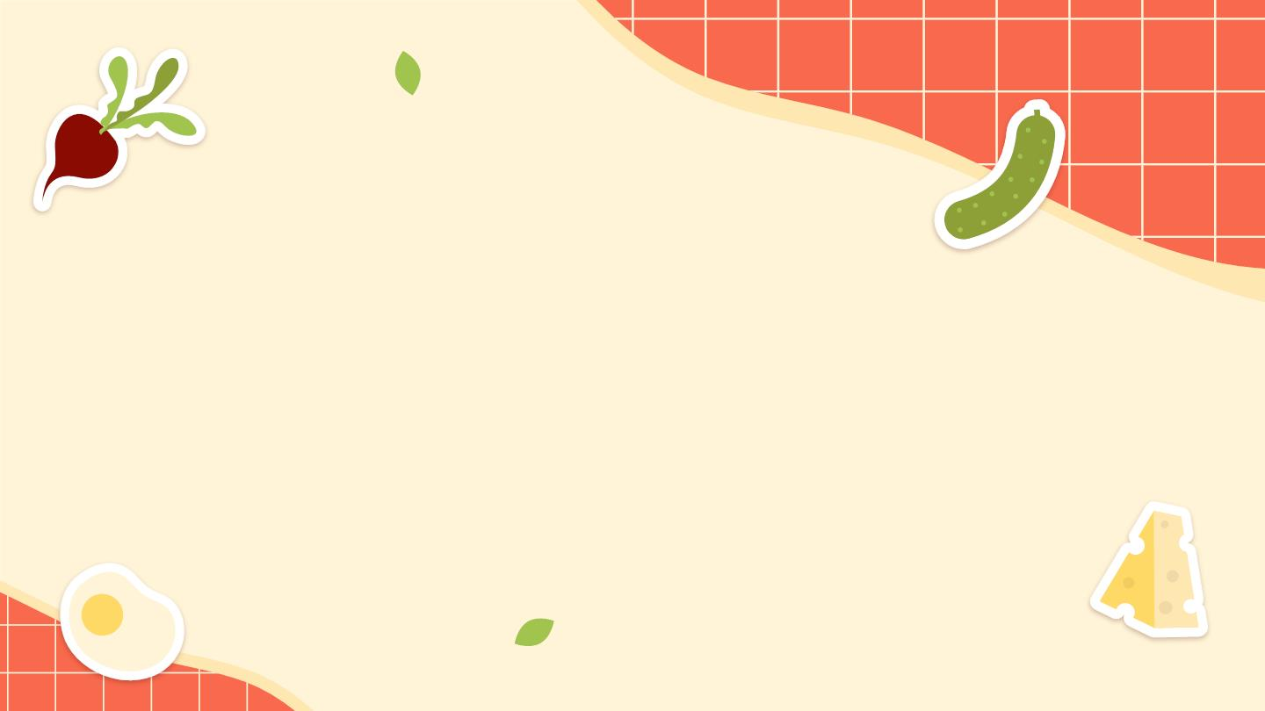
Onboarding
Our updated prototype includes
onboarding, where users can make
an account for the app and save their
dietary restrictions.
Onboarding also includes tutorials
on important features of the app.

Slide 12
Creating an
account.
To be able to save your preferences.

Slide 13
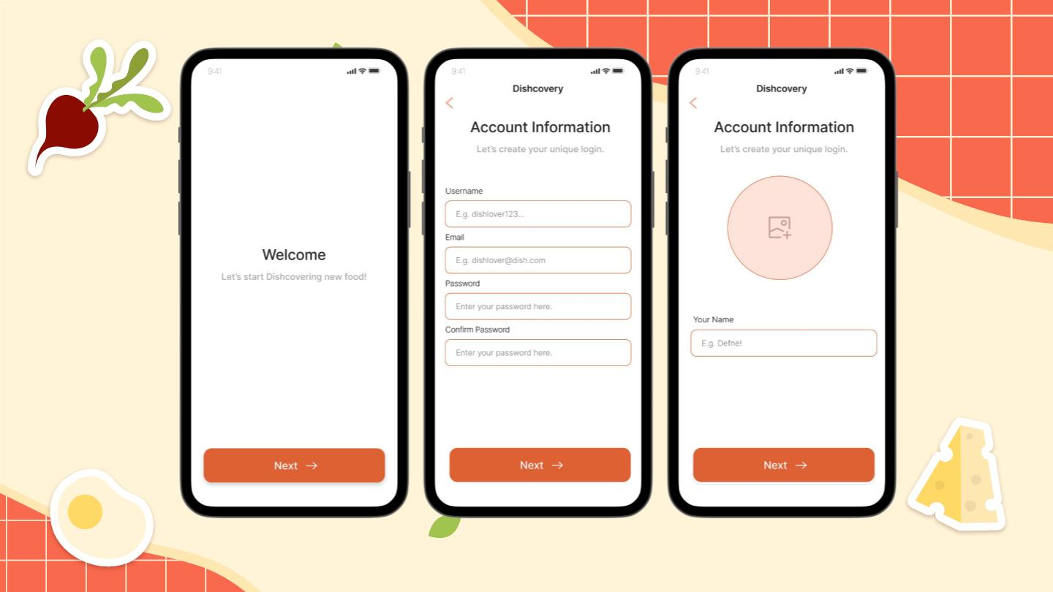

Slide 14
Setting up
dietary
preferences.
As part of our onboarding process.

Slide 15
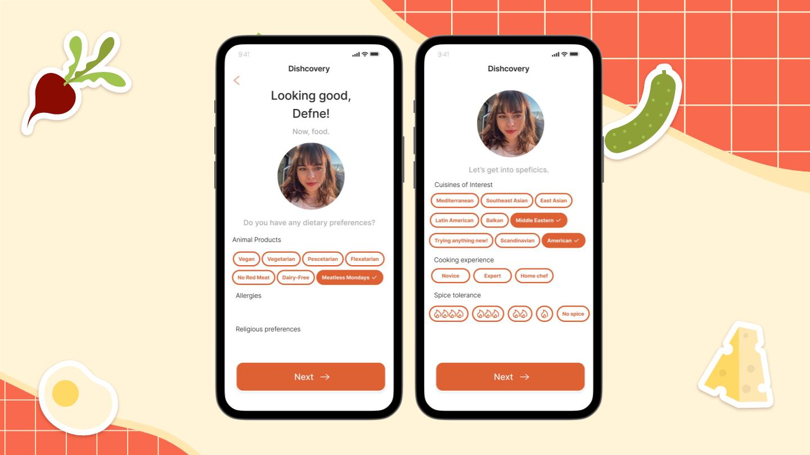

Slide 16
Tutorials
To make the central functionality of our
app clear.

Slide 17
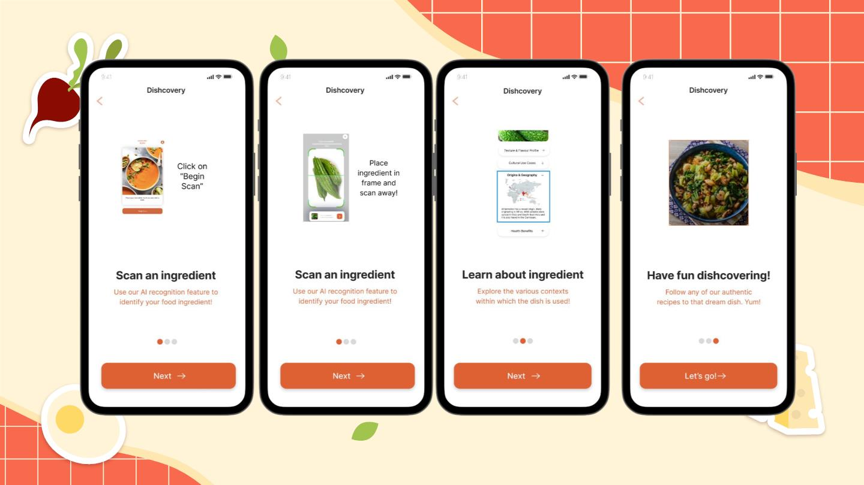

Slide 18
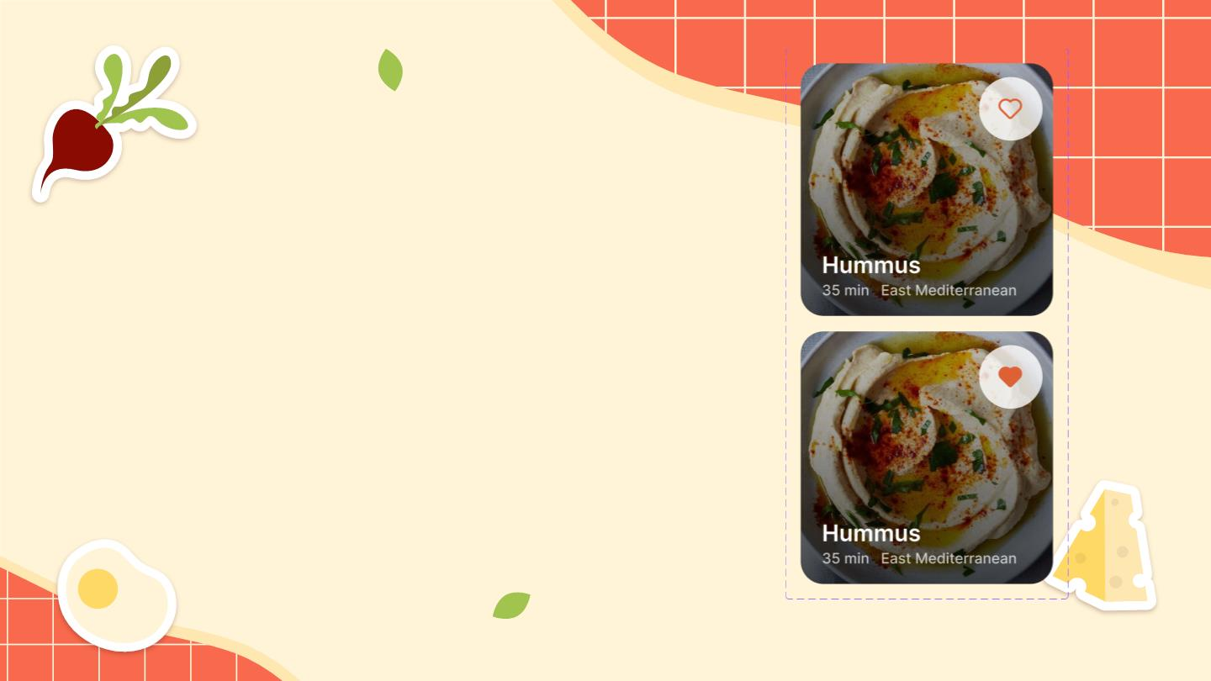
Dishcard Design
To make explore pages feel less
cluttered.

Slide 19
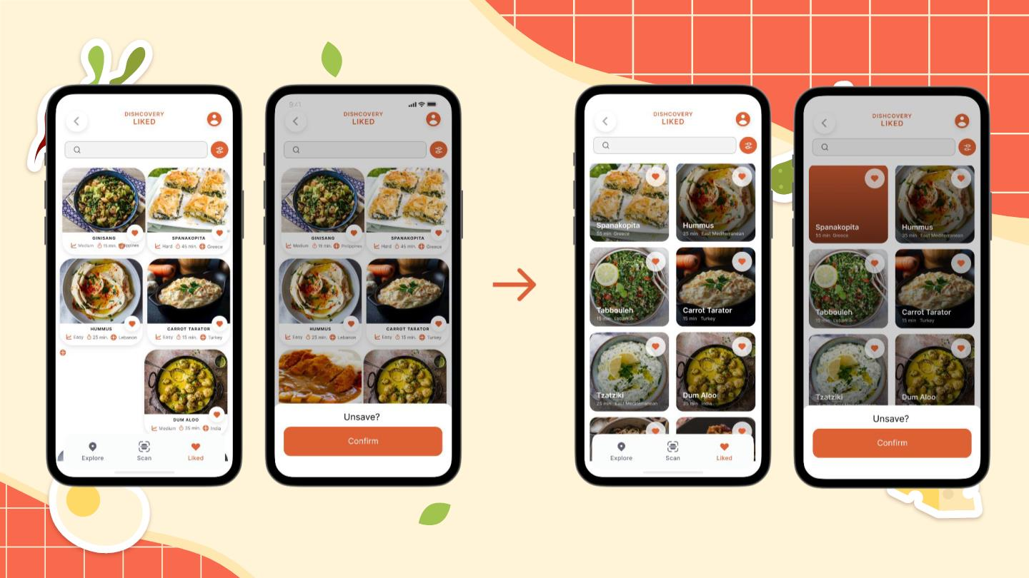

Slide 20
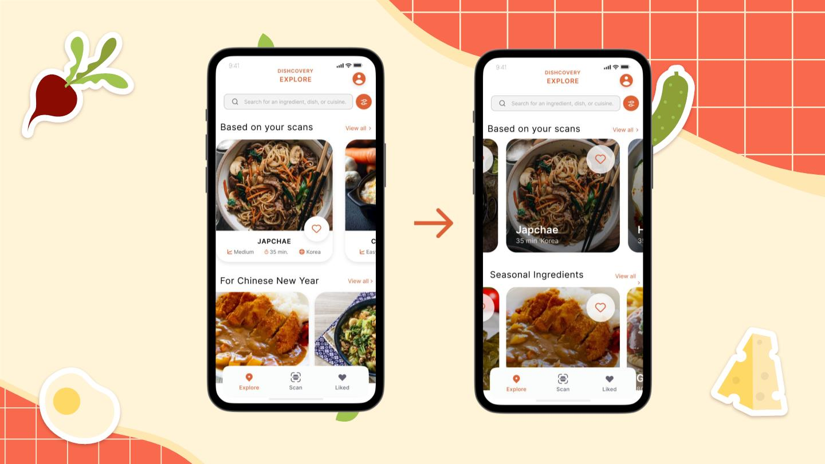

Slide 21
Scanning
After receiving feedback from our
participants in the usability test, we
removed the redundant “Begin Scan”
screen.
We also made changes to design of
our remaining scan screen.

Slide 22
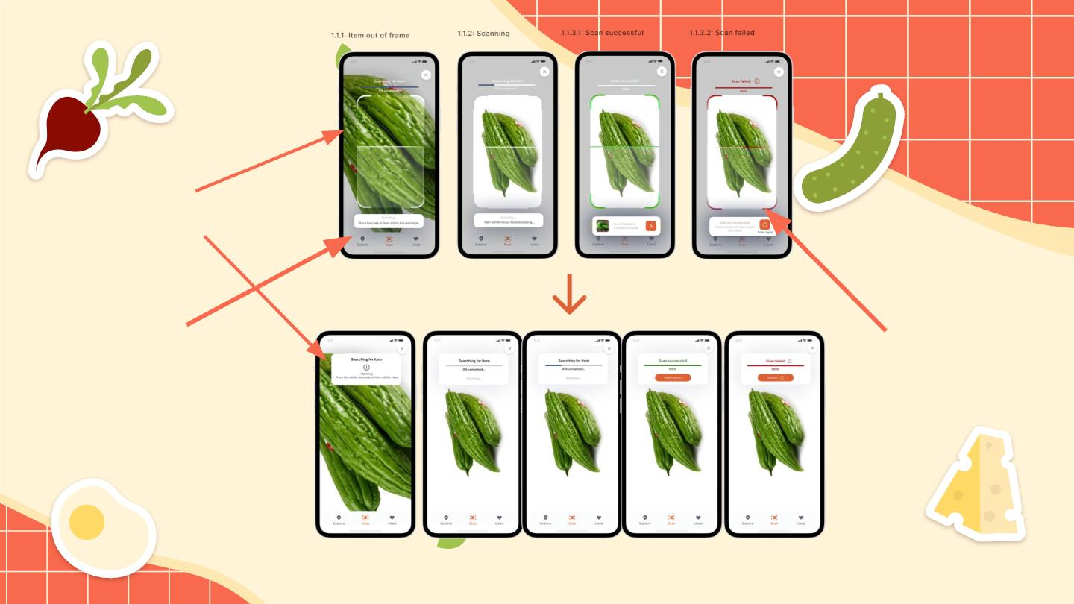
Condensed
information into
one section
Removed
aggressive
shadows
Removed
rectangle that
served no
function.

Slide 23
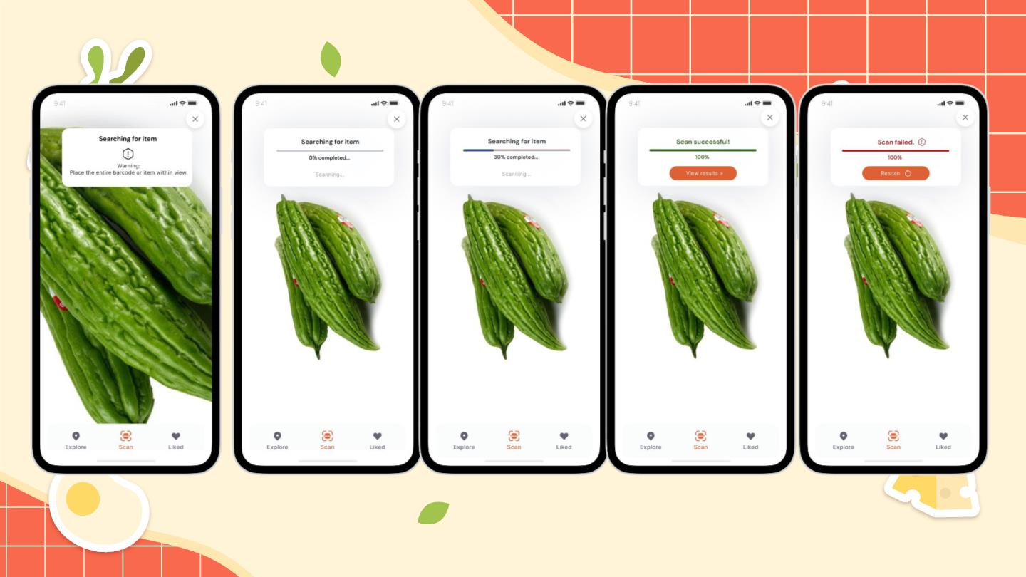

Slide 24
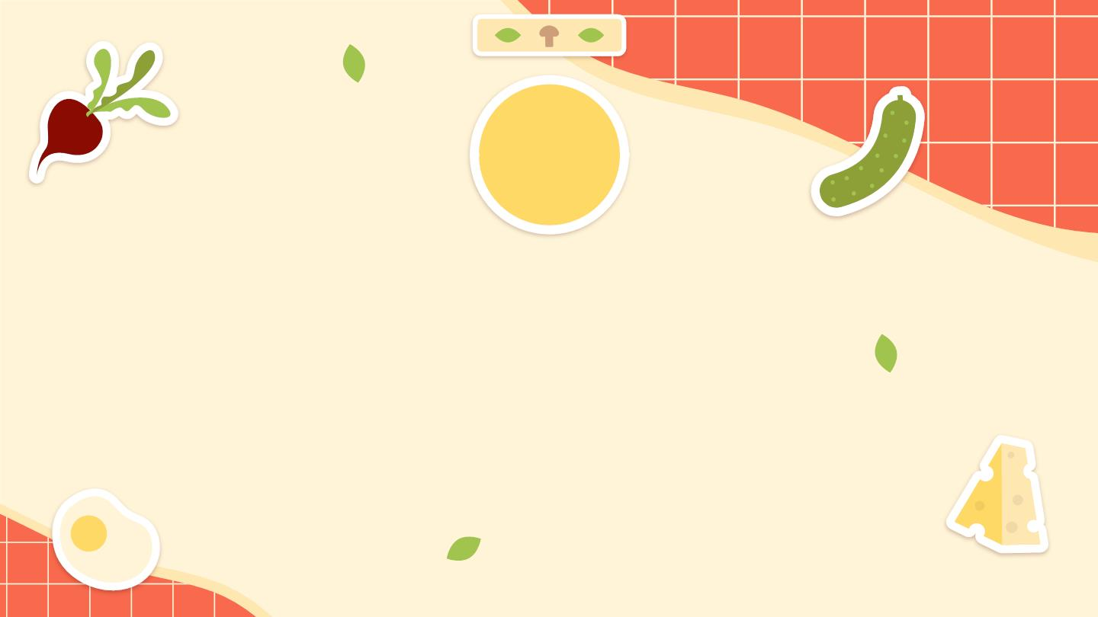
03
Task Flows

Slide 25
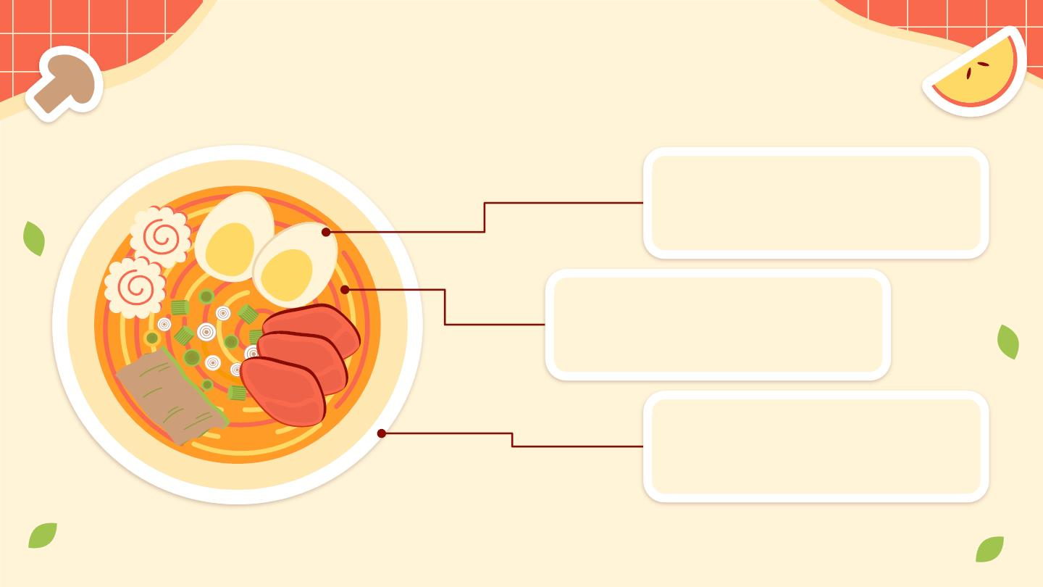
Recap of our Task Flows
Search
1
For an unfamiliar food
item through scanning.
Contextualise
2
Using the information
provided in the app.
Authentic Cooking
3
Through recipes the user
ﬁnds and/or saves.

Slide 26
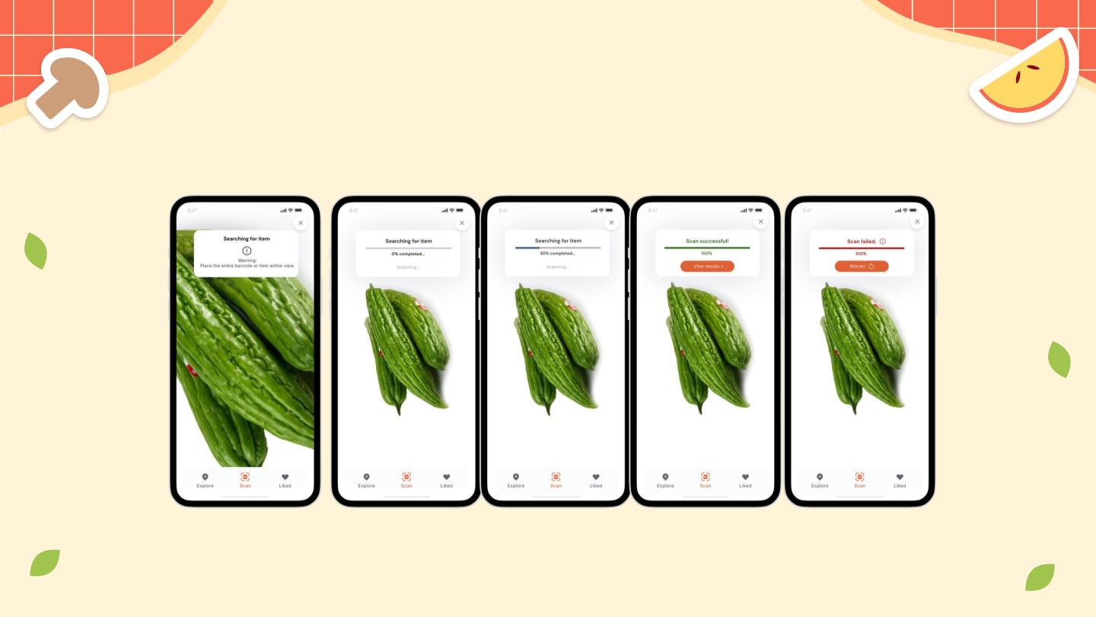
Scanning an ingredient.

Slide 27
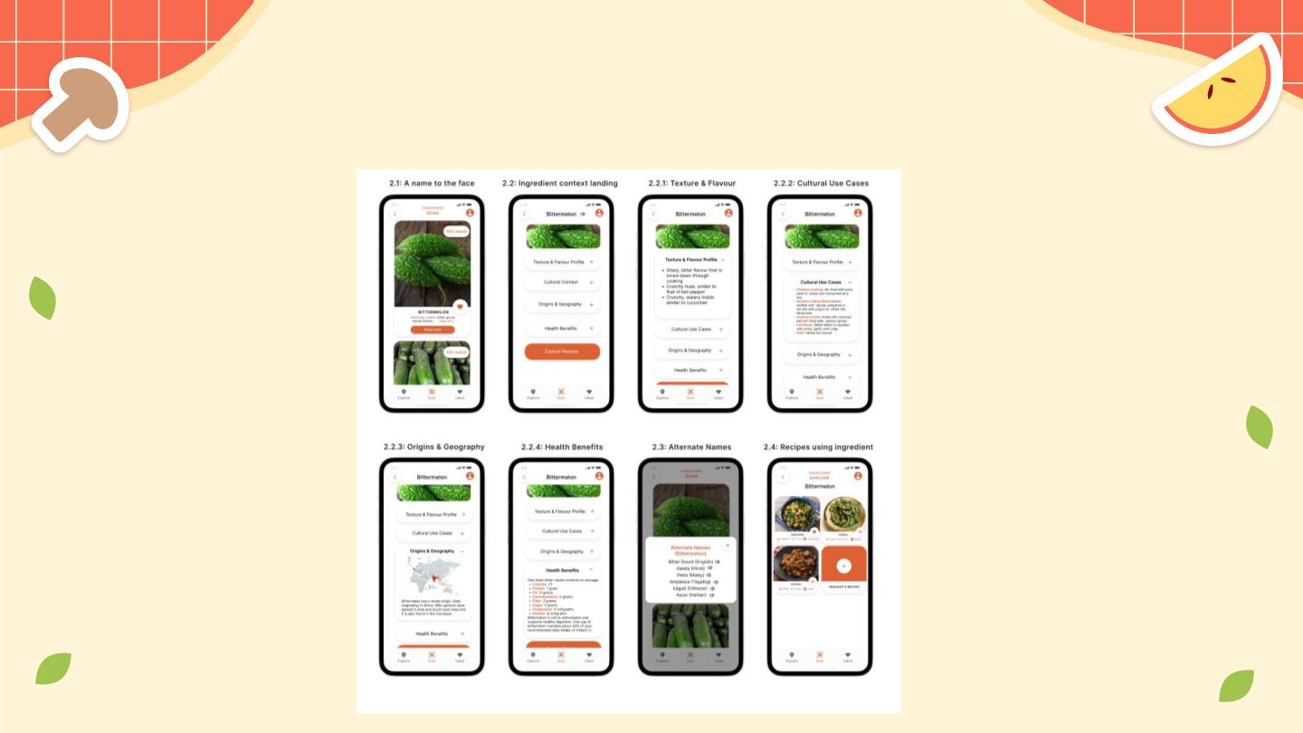
Ingredient context.
We kept this
mostly the
same, but have
room to make
more changes
in the next
iteration.

Slide 28
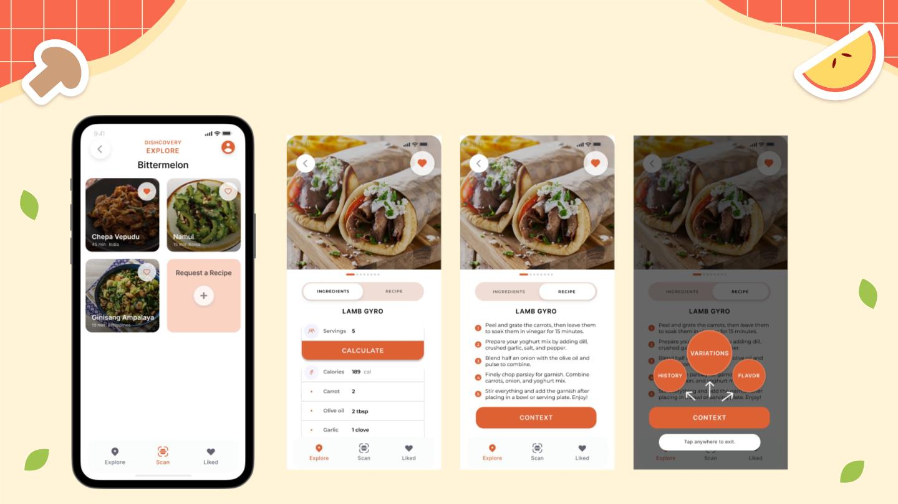
Cooking with t hat ingredient.

Slide 29
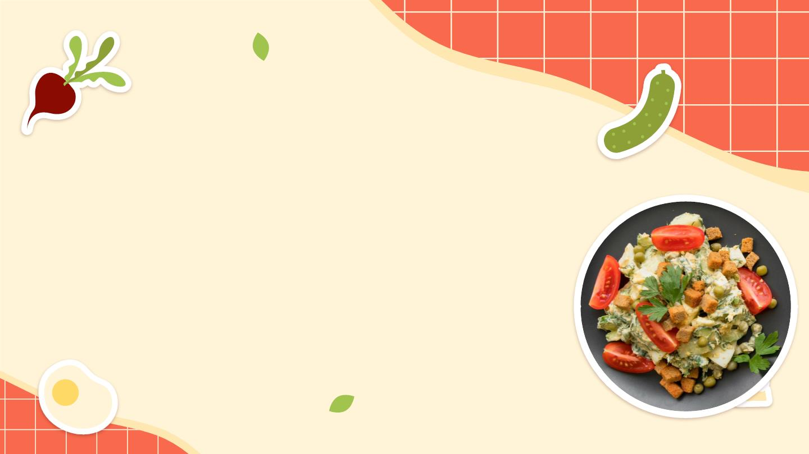
Backend
We used Firebase for our User
Authentication and Database.
Recipes and User Information are
currently stored in our Database.

Slide 30
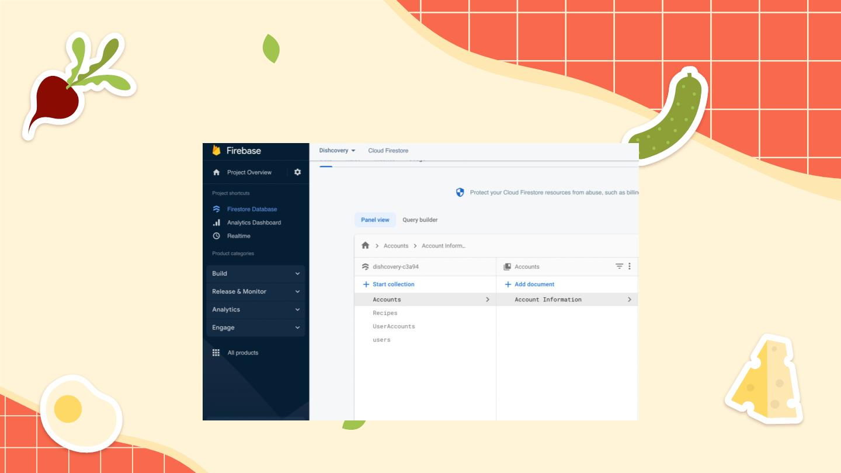
Backend

Slide 31
Authentic recipe
sourcing
How we collected our initial data from real
people with real experiences with
authentic cooking.

Slide 32
Method
We sent out a Google Form to as many people as possible and asked them
to share with friends and family.
We asked for a link to the closest recipe they could ﬁnd online to their
desired dish.
This ensured that the recipe sourcing process wasn’t too high-eﬀort for
these participants.

Slide 33
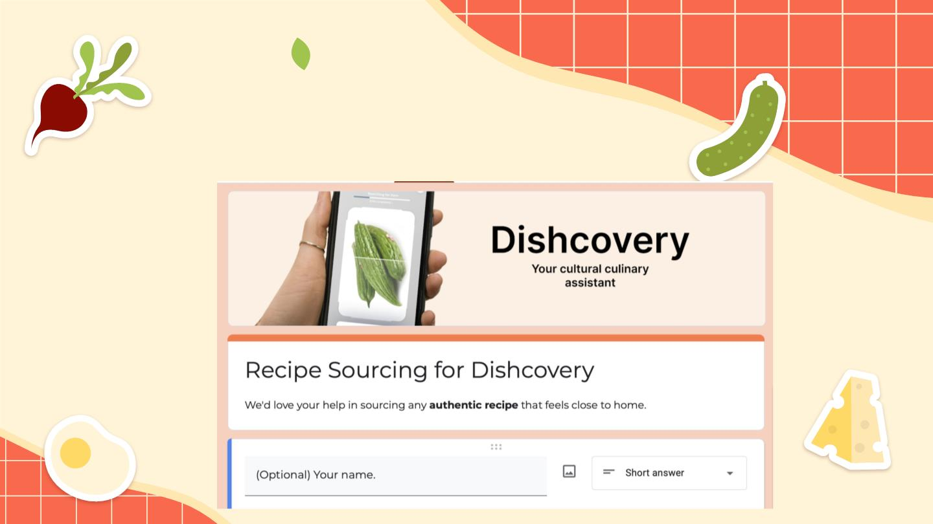
The Google Form

Slide 34
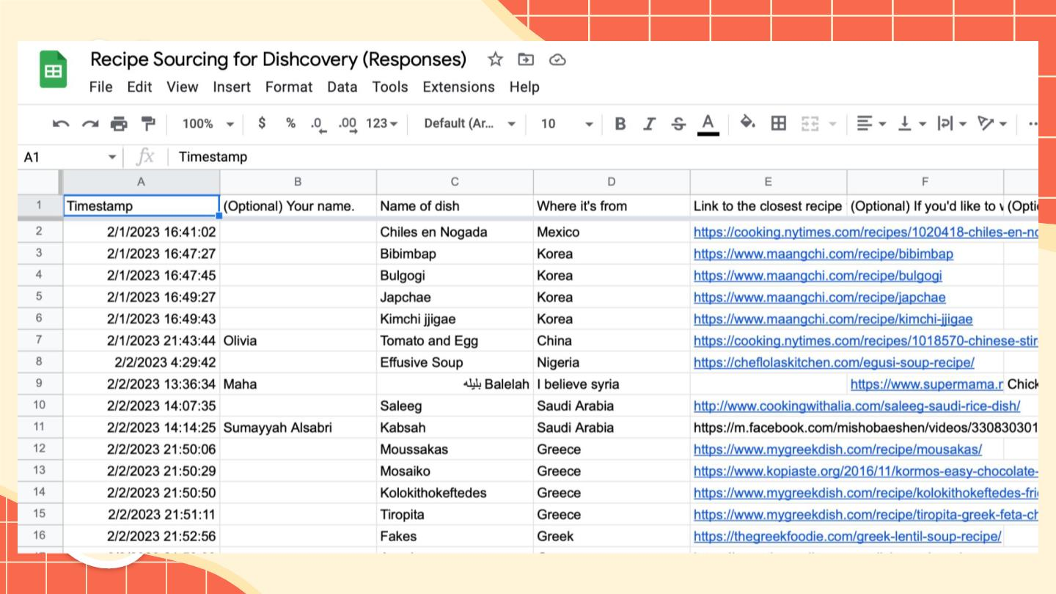

Slide 35

04
Future
Trajectory

Slide 36
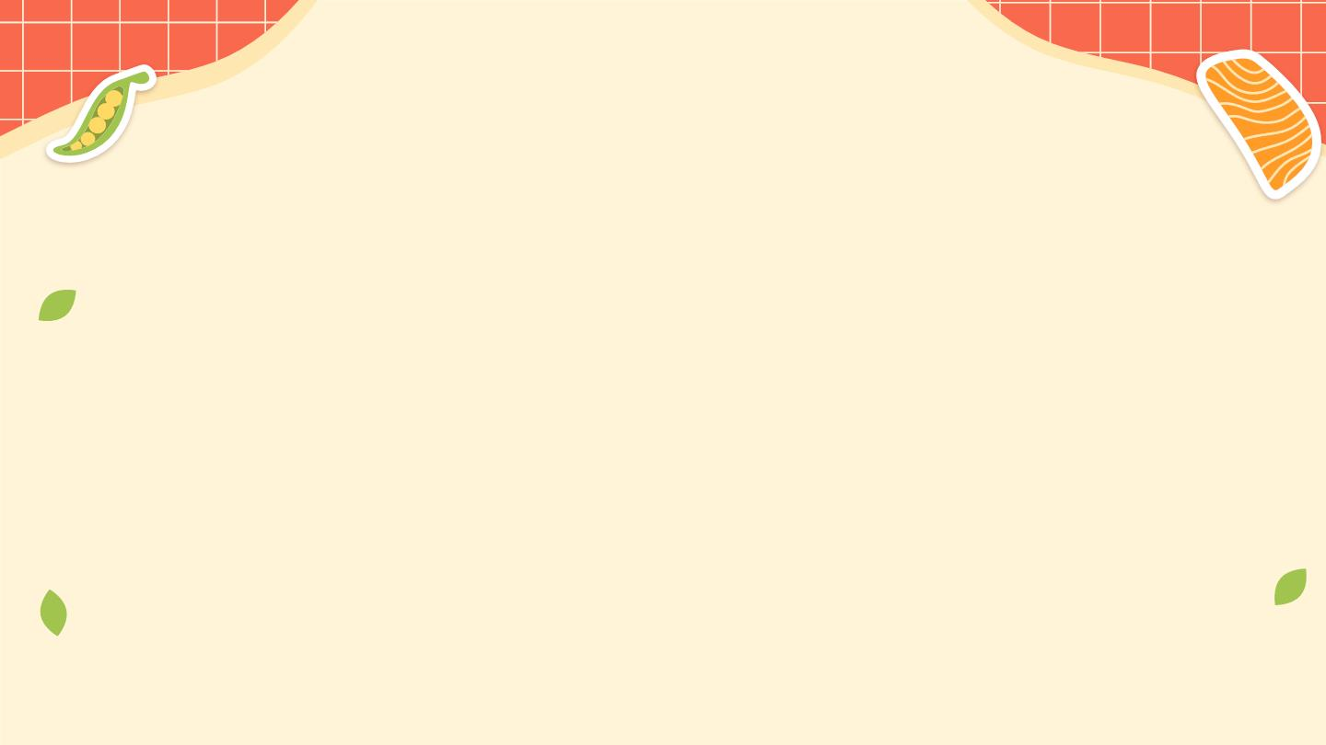
Wizard of Oz
Scanning
Data Fetching
●
Recipes and User data are
successfully stored in the
Firebase, but need some work
to fetch the data so it can
populate
●
We are currently having issues
with the scan feature, and are
working to resolve them.
The API does still work but we
need to sort out issues with
React dependencies and
brainstorming a way to use
the API long-term
●
●
We’ve been manually sourcing
recipes from people and their
families.

Slide 37
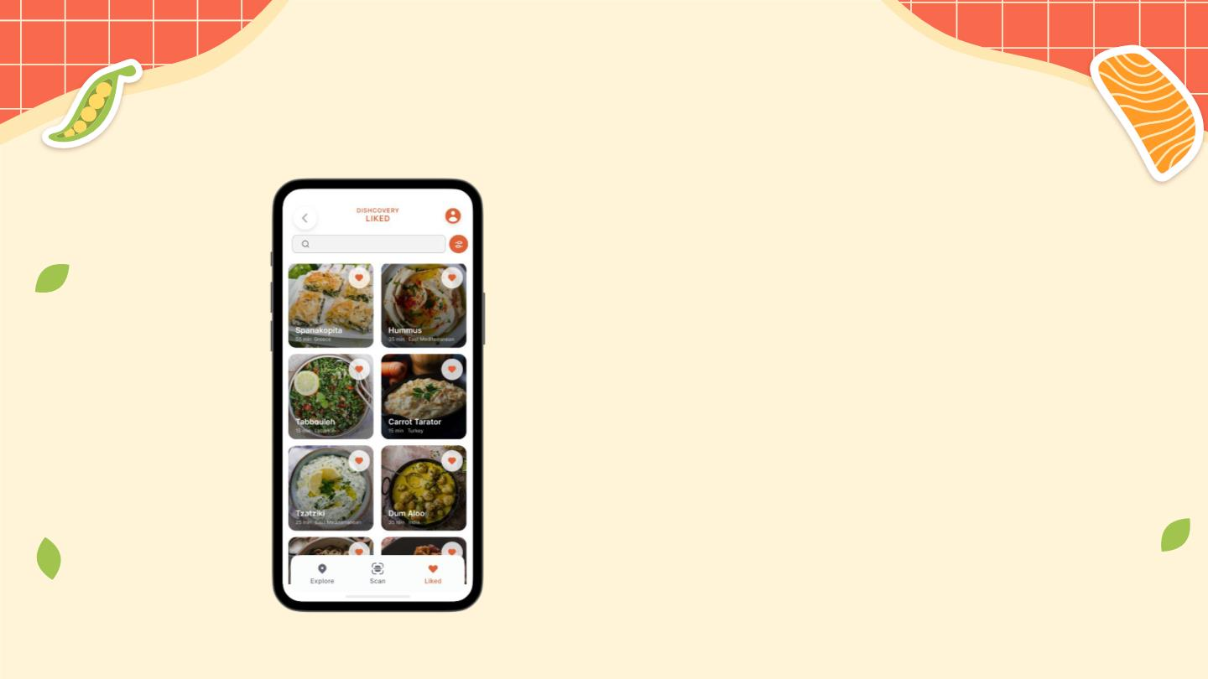
Hard Coded
Liked Recipes
●
Liked recipes from an example
user are still hard coded. After
we improve our backend and
successfully fetch user data,
we will populate this from the
database.
Recipe
Recommendations
●
The recipes on the Explore Tab
are currently hardcoded.

Slide 38
More t hat we hope to implement
● Dietary preferences informing “smart”
recommendations (explained later)
● More permanent image recognition solution than API
key.
● Sourcing more recipes from real people but also
researching and adding recipes ourselves every week.
● Completing the continuation of the “Context” under
recipe screens and devising more ways for sourcing and
presenting recipe context.

Slide 39
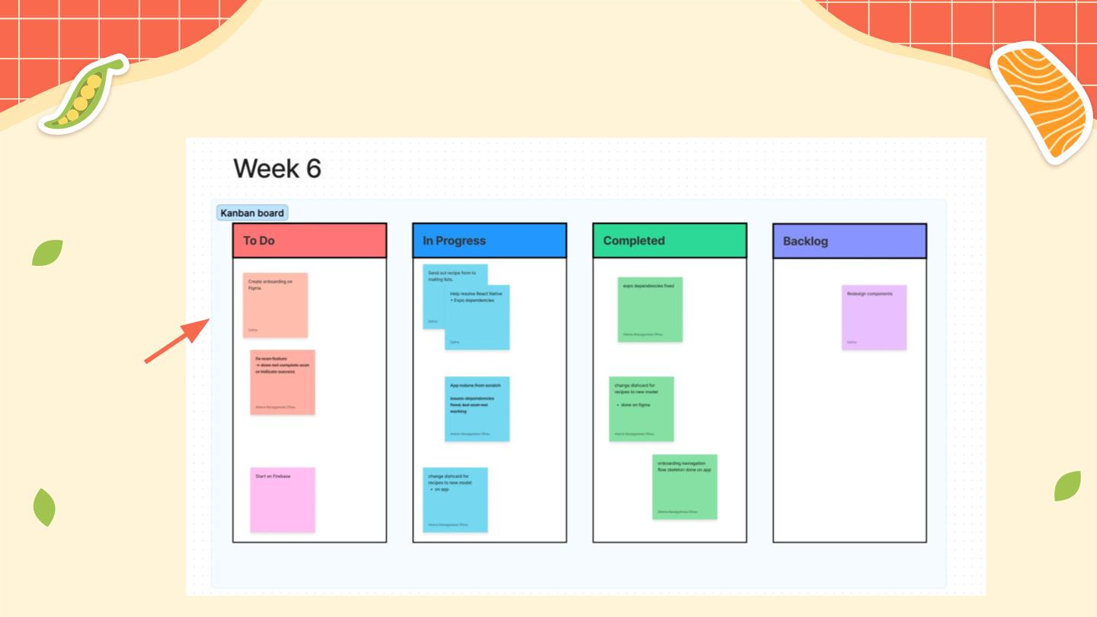
How we’re managing tasks
Kanban
board

Slide 40
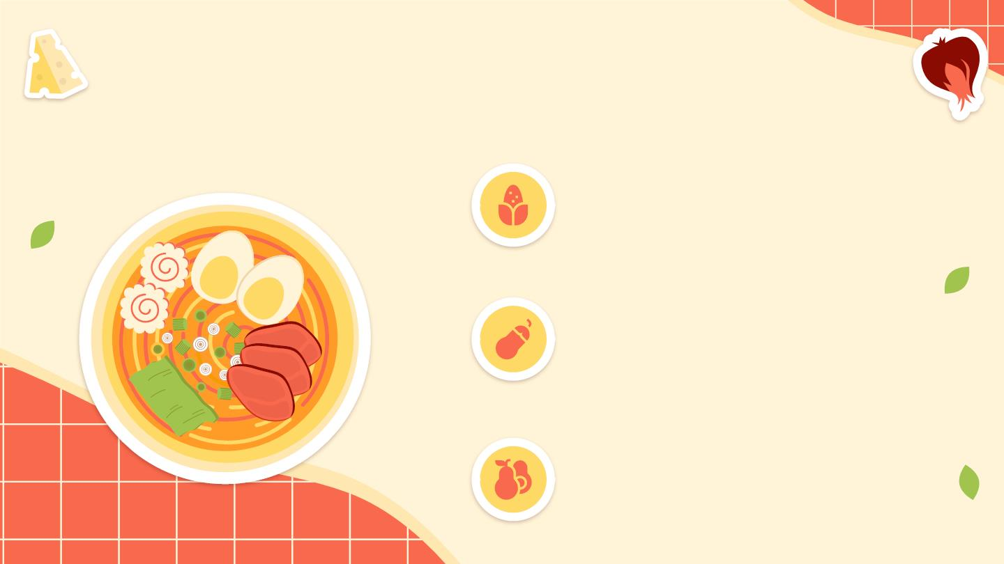
Future Technical Work
Improve Backend
Remove hard coding and fetch data
eﬀectively.
Recipe
Recommendations
Use AI for the Explore Tab in order to
recommend recipes relevant to the
user.
User settings
Allow for in-app adjustments of user
settings and dietary restrictions apart
from onboarding

Slide 41
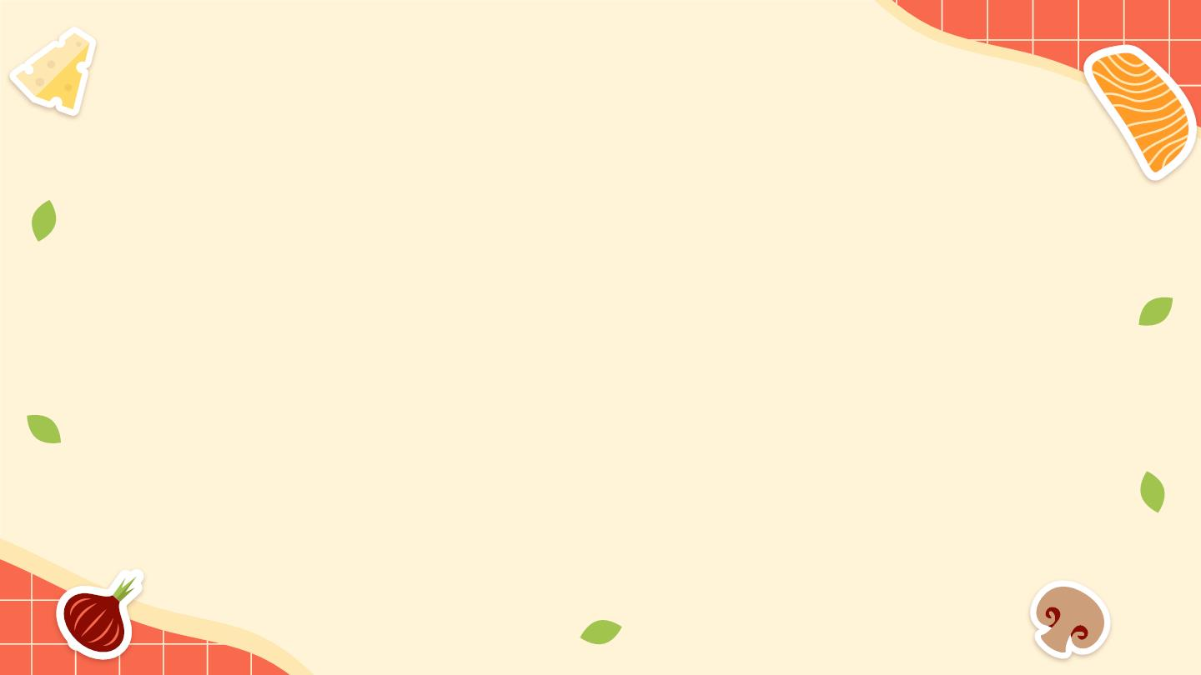
THANK YOU!

Slide 42
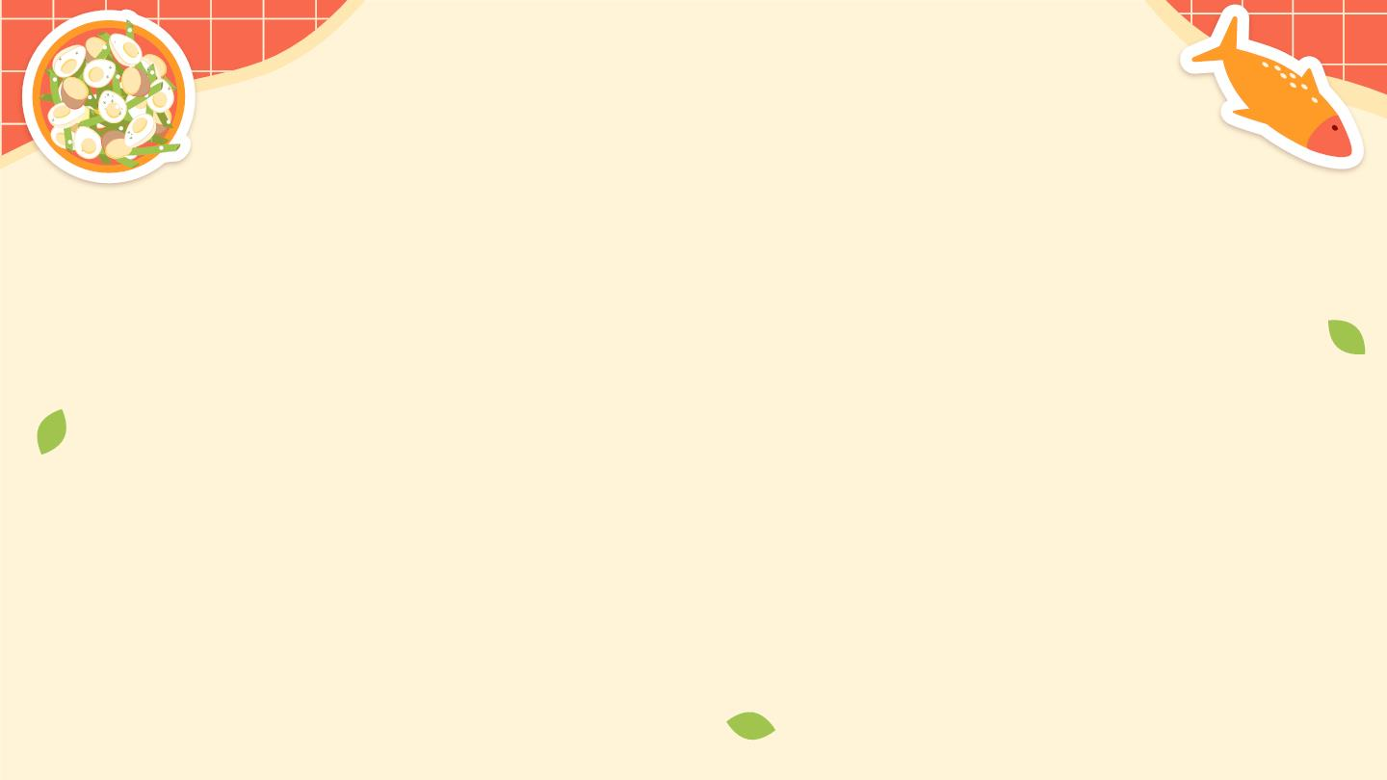
Appen-dish
Updated Figma link:
https://www.ﬁgma.com/ﬁle/tyDILZR1T2Z7Fmq4NTKeey/Dishcovery-Version-3?node-id=52%3A2419&t
=Thj1HgKMRUSz18lB-1

